Slide 1
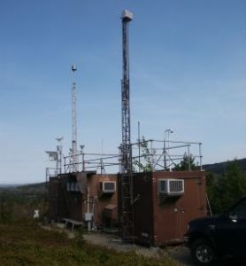
AQS Metadata Requirements
2012 AQS Conference
Providence, RI
Ambient Monitoring Perspectives and Priorities

Slide 2
AQS Metadata
EPA is currently reviewing and asking monitoring agencies to update, where appropriate, certain key metadata fields associated with sites and monitors in AQS
Topic was the addressed at the recent National Ambient Air Monitoring Conference in Denver, CO on May 16, 2012
  See: http://www.epa.gov/ttn/amtic/2012present.html
  Data Roadmap – From Monitoring Regulations to National Databases. A review of monitoring definitions and metadata fields with a crosswalk of how that information is stored in AQS
With consideration of the input received during this session, the EPA-OAQPS monitoring group is providing a memo and detailed spreadsheets to Regions requesting updates to metadata.
EPA Regional Offices will be sharing this information with monitoring agencies.

Slide 3
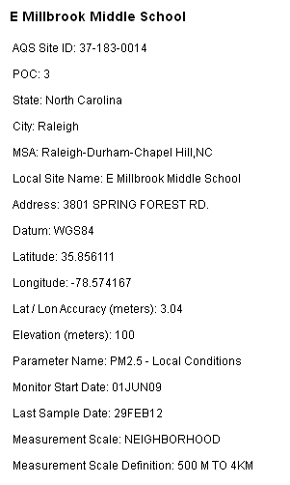
Why are Metadata Important?
Consistency of metadata across networks is critical to ensuring appropriate interpretation and use of the data.
  e.g., Health studies may be under-utilizing pollution data where key metadata is missing or labeled incorrectly.
With a large investment by EPA and monitoring agencies to collect data, its important to maximize the data’s utility with the appropriate metadata
Assessment tools are becoming more readily available with a large number users; need to provide enough key information to address most common questions.
Availability of tools such as Google maps provides visual ground truth with AQS entries
Metadata from
AirData web site
(www.epa.gov/airdata/)

Slide 4
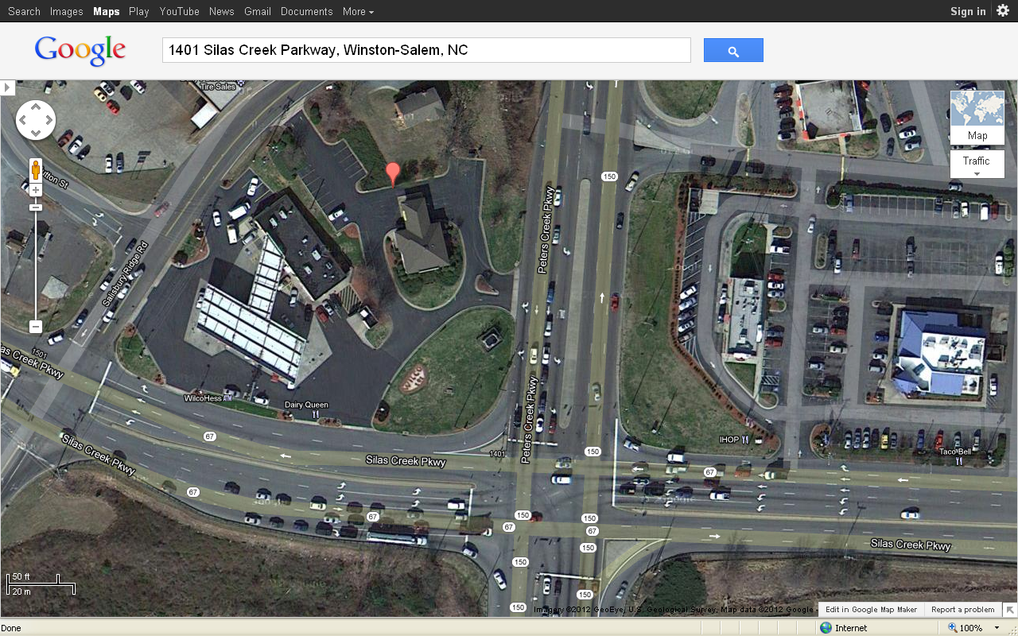
AQS ID 37-067-0023
Microscale CO monitor

Slide 5

Many metadata fields in AQS are referenced in the Monitoring Regulations
40 CFR, Part 58 – Ambient Air Quality Surveillance
Definitions connected to AQS metadata
  SLAMS, SPM, PQAO
Annual Monitoring Network Plans §58.10
Sample Frequency Requirements
Quality Assurance in Appendix A
Methodology in Appendix C
Network Design in Appendix D
  Spatial scales are detailed for each NAAQS pollutant
Probe and Siting Criteria in Appendix E

Slide 6
Requirements for the
Annual Monitoring Network Plan
§ 58.10 (b) The annual monitoring network plan must contain the following information for each existing and proposed site:
(1) The AQS site identification number.
(2) The location, including street address and geographical coordinates.
(3) The sampling and analysis method(s) for each measured parameter.
(4) The operating schedules for each monitor.
(5) Any proposals to remove or move a monitoring station within a period of 18 months following plan submittal.
(6) The monitoring objective and spatial scale of representativeness for each monitor as defined in appendix D to this part.
Green = Generally populated very well in AQS
Maroon = Identified as needing improvement

Slide 7
Requirements for the
Annual Monitoring Network Plan - Continued
(7) The identification of any sites that are suitable and sites that are not suitable for comparison against the annual PM_{2.5} NAAQS as described in §58.30.
(8) The MSA, CBSA, CSA or other area represented by the monitor.
(9) The designation of any Pb monitors as either source-oriented or non-source-oriented according to Appendix D to 40 CFR part 58.
(10) Any source-oriented monitors for which a waiver has been requested or granted by the EPA Regional Administrator…
(11) Any source-oriented or non-source-oriented site for which a waiver has been requested or granted by the EPA Regional Administrator for the use of Pb-PM₁₀monitoring in lieu of Pb-TSP monitoring…
(12) The identification of required NO₂monitors as either near-road or area-wide sites in accordance with appendix D, section 4.3 of this part.
Purple = not provided for in AQS
Green = Generally populated very well in AQS
Maroon = Identified as needing improvement

Slide 8
Status of Monitoring related Improvements to AQS we are working on:
Items we are asking be implemented now:
For criteria pollutants, migrating “Monitor Type” back to its original definition (the administrative classification of the monitor) (e.g., SLAMS, SPM, Tribal, Industrial)
Discontinue use of “QA Collocated” with Monitor Type; use “Monitor Objective” to describe these instead.
Items we intend to work towards:
Allowing easier identification of method in daily and annual summary reports
Making better use of the “Parameter Classification” table – e.g., for CSN, IMPROVE, NATTS
Having a different field available to identify the technical network a monitor is associated with. This is the other part of how “Monitor Type” is used now. (e.g., IMPROVE, NCore, NATTS)
Deleting “Collection Frequency Description” since this is somewhat redundant with “Required Collection Frequency Code”.
  May delete “Required” from above for use with other pollutants.

Slide 9
Monitor Type is defined as “The Administrative Classification of the monitor”
The first three columns are currently available as a “Monitor Type”
For criteria pollutants we recommend using a Monitor Type from the first column.
Network Affiliations
IMPROVE
Other Information
Index Site
Non-Regulatory
Monitor Types
SLAMS
Special Purpose
Tribal Monitors
Industrial
Other Federal
Trends Speciation
Supplemental Spec.
NATTS
NCore
PAMS
Unofficial PAMS
Legacy Monitor Types
Other
NAMS
WHO
WMO
QA collocated

Slide 10
Current Status of Monitor Type Reporting to AQS for Filter-based PM_{2.5} FRM/FEM monitors
Monitor Type | Monitor Types Associated with a Filter-based PM_{2.5} FRM/FEM monitor
SLAMS | 766
Special Purpose | 99
Tribal Monitors | 18
Industrial | 2
NCore | 60
QA Collocated | 58
Non-Regulatory | 11
Other | 67
Individual Number of stations Reporting | 872
Monitor Type is
required and it
can be populated
multiple times.
Red = ones that
should no longer be
used
“Non-Regulatory” may be applicable for certain PM_{2.5} continuous FEMs also labeled with a Monitor Type of “Special Purpose”

Slide 11
Measurement Scales for PM_{2.5} Sites
Reporting a filter-based FRM/FEM to AQS
Measurement Scale | Area represented | Number of Filter-Based PM_{2.5} Monitors in each scale Reporting to AQS
Microscale | Up to 100 meters | 4
Middle Scale | 100 meters to 0.5 kilometers | 23
Neighborhood | 0.5 to 4.0 kilometers | 585
Urban Scale | 4 to 50 kilometers | 108
Regional Scale | Tens to hundreds of kilometers | 59
Null |  | 93
Totals |  | 872
Measurement Scale
is not currently required; however, it is well documented in Appendix D for criteria pollutants and required in annual monitoring network plans
Red = ones that
should no longer be
used

Slide 12
Monitoring Objectives for PM_{2.5} Sites Reporting a filter-based FRM/FEM to AQS
At least one
Monitoring Objective
is required, but more
than one can be
Populated
Green = Monitoring Objectives expected for rural monitors
Blue = Monitoring Objectives expected for urban/suburban monitors
Orange = descriptive information that can be used. Usually as a second monitoring objective.
Red = ones that
should no longer be
used
Monitoring Objective | Number of Filter-Based PM_{2.5} Monitors Reporting to AQS
Upwind Background | 13
General Background | 60
Regional Transport | 44
Population Exposure | 747
Highest Concentration | 80
Source Oriented | 25
Max Precursor Emissions Impact | 3
Max Ozone Concentration | 1
Extreme Downwind | 2
Welfare related impacts | 3
Other | 34
Unknown | 10
Quality Assurance | 15
Totals at 872 stations | 1037

Slide 13
Common Site Level Fields –
That Need Attention:
Field | Required in AQS? | Example | Recommendations
Street Address | No | Queens College 65-30 Kissena Blvd Parking Lot#6 | Should field be required? At a minimum recommend populating field with address from annual monitoring network plans
Latitude and Longitude | Yes | 40.736140, -73.821530 Please update w/ GPS derived coordinates if needed. | Set to Latitude and Longitude to the EPA Standard for horizontal datum - WGS84. Many but not all sites have migrated to this datum. See 8/28/07 Memo - Procedure to populate Standard Coordinates on AQS memo web page at: http://www.epa.gov/ttn/airs/airsaqs/memos/
Local Site Name | No | Queens College 2 | Recommend having this populated with a conventional name for the site. This makes it easier when discussing data with stakeholders. AIRNow does have site names. At this point we are not recommending making this mandatory for AQS.

Slide 14
Common Monitor Level Fields – that Need Attention:
Field | Required in AQS? | Example | Recommendation(s)
Monitoring Objective | Yes | Population Exposure | Establish consensus on use of available fields.
Measurement Scale (Spatial Scale of Representativeness) | No | Neighborhood | Recommend requiring this field for criteria pollutants. Should it be required for any other measurements?
Monitor Type | Yes | SLAMS | Realign field so that only one “Monitor Type” can be loaded per monitor. Move technical aspects of existing monitor types to another field

Slide 15
Summary of Recommendations for EPA to work on:
Monitor Type - Realign field so that only one “Monitor Type” can be loaded per monitor. Move technical aspects of existing monitor types to another field
Require Measurement Scale for criteria pollutants
Discontinue use of “QA Collocated” as a monitor type
Make better use of Parameter Type to group common measurements for programs such as NATTS
Continue to communicate these and other changes
Other?

Slide 16
Summary of Recommendations for Monitoring Agencies to Work on:
Populate street address in AQS from annual monitoring network plans
Align Latitude and Longitude with EPA standard datum (WGS84) and ensure coordinates are GPS derived
Populate Local Site Name
Align monitoring objectives across agency network
Populate spatial scale of representativeness for criteria pollutants
For criteria pollutants, align Monitor Type with the appropriate selections – usually SLAMS, SPM, Tribal
  For collocated monitors use the same Monitor Type as the Primary Monitor rather than “QA Collocated”

